Slide 1

Team GVSU FFPAC Web Application
Members: Chris Schaefer, Laura Young and Chad Mersino

Slide 2
Introduction to FFPAC
Faculty Facilities Planning Advising Committee
Committee of GVSU Faculty that overviews classrooms on campus
Perform a walkthrough on both campuses and visit each classroom
Mark any needed changes / issues with that specific classroom
This information is used to make changes and can impact the following school year with classroom delegation
Needed an application to centralize their information along with making it accessible to every member

Slide 3
Ideal Web Application
Two main pieces for this application to be successful
Easy to use front end application to generate new complaints for a classroom
Back end database that stores this information and can be referenced at any time
Front end application must be accessible through multiple mediums due to on the fly entries
Database must be specific to cater all the information that needs to be stored
Allow for user accounts to increase security of this data
GVSU themed application to give the users a more professional feeling

Slide 4
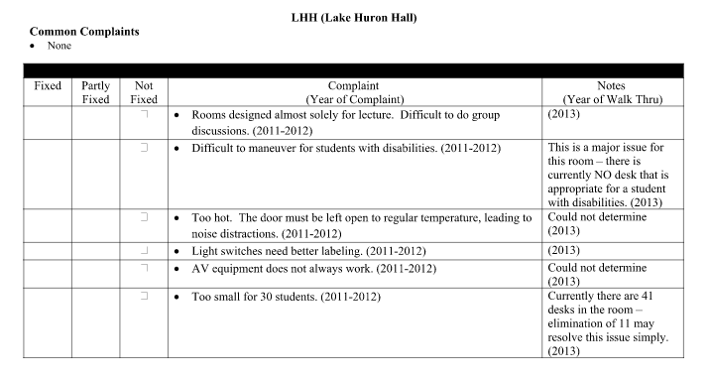
Old System
41 Pages:

Slide 5
New System
Mobile friendly application that organizes stored information
References any classroom on both campuses
Displays specific characteristics of a given room on campus
Displays a leaderboard of the worst classrooms/buildings/campuses with most complaints
User dependent permissions to view certain aspects of the system

Slide 6
Technology Used
AMP Stack [Apache, MySQL, PHP, Perl]
PHP
Wordpress PHP Framework
Template hack
Custom database class to build SQL

Slide 7
Development Process
Get in depth understanding of what the client wants
Set goals (via weekly increments) to enact features to the application
Receive feedback from clients and work on their revisions
Gives us something to work after and updates us on how our vision of the application holds up compared to what the client wants
Keep adding features that we think would benefit the application
Rinse and repeat

Slide 8
Setbacks
Live instance on GVSU servers
Special features
Map of campus to select rooms, email notifications, connecting to existing databases that faculty/maintenance has, generating a user session before uploading data to main tables
Avoiding scope creep towards the end of the semester

